Slide 1






SRM INSTITUTE OF SCIENCE AND TECHNOLOGY
Kattankulathur , 603203
DSA PROJECT -
TOPIC - CASH FLOW MINIMIZER
Members-
Ritvik Rajvanshi
(RA2211003010792)
Akshat Mittal
(RA2211003010790)
Yugam Shah
(RA2211003010796)
Presented to - Dr. Sindhuja M

Slide 2



CASH FLOW MINIMIZER

Slide 3
CASH FLOW MINIMIZER
The Cash Flow Minimizer project is a sophisticated application that leverages the principles of data structures and algorithms to tackle the complex task of optimizing cash flow within a group of individuals. At its core, the project employs a graph data structure to elegantly represent the individuals involved and the debts existing between them. This innovative approach allows for a holistic view of the financial relationships within the group. The project's objective is to determine the smallest number of transactions necessary to settle the debts between a group of people.
To efficiently identify key individuals with the highest and lowest debt loads, the project cleverly utilizes heaps—an essential data structure in the realm of algorithmic efficiency. By strategically determining these extremes, the program orchestrates transactions between the parties involved, systematically reducing the overall debt burden. This iterative process continues until all debts are effectively settled.
To keep track of transactions and their sums, the project also uses multisets, a data structure that enables storing numerous instances of the same information. The multisets assist in determining the least number of transactions necessary to pay off the debts.
The Cash Flow Minimizer project serves as an example of the power and adaptability of DSA in dealing with practical issues. The project is especially helpful in situations where it is difficult to determine the minimum number of transactions necessary to settle the debts between a group of people.

Slide 4
PROBLEM DEFINITION-
The Cash Flow Minimizer project addresses the optimization of cash flow within a group of individuals who have financial transactions and debts among themselves. The primary objective is to determine the smallest number of transactions required to settle all debts within the group efficiently.
PROBLEM EXPLANATION-
Imagine a scenario where individuals within a group owe money to each other. This interconnected web of debts forms a complex graph. Each person represents a vertex, and each financial transaction is an edge connecting two individuals. The task is to settle these debts using the least number of transactions.

Slide 5
A B
|\ /|
Consider the following diagram:
In this example, A owes money to B, B owes money to C, C owes money to D, D owes money to E, and E owes money to A. The goal is to find the optimal set of transactions to settle these debts.
| \ / |
| \ / |
| C |
| / \ |
Data Structure Used:
The project employs a graph data structure to represent individuals and their financial relationships. Each person is a vertex, and each debt is an edge. Additionally, heaps are utilized to efficiently identify individuals with
| / \ |
|/ \|
the highest and lowest debt loads, facilitating the decision-making process for transaction generation. The project also leverages multisets to manage and track multiple instances of transaction information.
D----E

Slide 6
Demo/Simulation:
Initial Debt Configuration:
A owes money to B B owes money to C C owes money to D D owes money to E E owes money to A
Algorithm Execution:
Use heaps to identify individuals with the highest and lowest debt loads. Generate transactions between these individuals to settle debts.
Update the debt information and repeat until all debts are settled.

Slide 7
Optimized Transactions:
A pays B B pays C C pays D D pays E E pays A
Final Debt Configuration:
All debts are settled, and the cash flow is optimized.

Slide 8
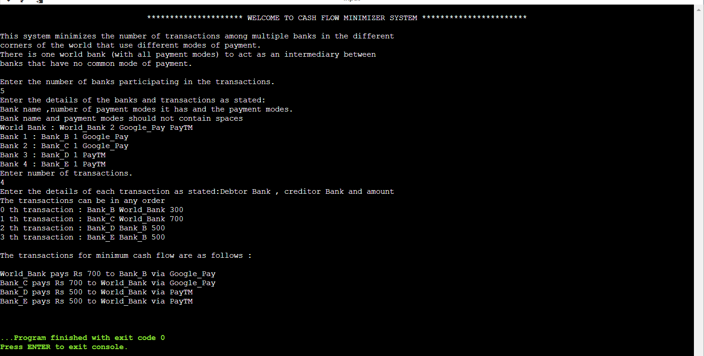
SCREENSHOT OF OUTPUT-

Slide 9
CONCLUSION-
In conclusion, the Cash Flow Minimizer project has been a significant achievement in harnessing the power of data structures and algorithms to streamline the intricate process of settling debts within a group. By employing graph representations, heaps, and multisets, the project successfully navigated the complexities associated with financial relationships, offering an efficient solution to minimize the number of transactions required.
Throughout the development, key features such as the utilization of heaps for identifying optimal transaction candidates and the versatility of multisets in managing transaction data have proven instrumental. The project not only met its objective of settling debts but also demonstrated the practicality and adaptability of data structures and algorithms in addressing real-world challenges.

Slide 10
Thank you!!

